Slide 1
ATS Resume/File Keyword Scanner
Name: Sahil Dhawan
Gmail: sahil22dhawan@gmail.com
Company: Sopra steria
Mentor Name: Abhishek Thapar

Slide 2
Problem Statement
Companies receive hundreds of resumes daily.
Manual screening is time-consuming and inconsistent.
There is a need for a smart tool that scans files for specific job keywords.
Such a tool would help recruiters shortlist relevant resumes faster.

Slide 3
Objectives
Develop a Python-based Resume Scanner that:
Reads .txt, .pdf, and .docx files
Searches for specific keywords (e.g., “Python”, “SQL”, “Excel”)
Displays results with ✅ and ❌ indicators

Slide 4
Technologies Used
Component | Technology
Programming Language | Python
GUI Framework | Tkinter
Libraries | PyPDF2, python-docx, os
Output | Keyword Match Summary

Slide 5
Working of the Project
User selects a folder containing resumes
Enters job-related keywords
Program scans each file
Matches keywords inside text
Displays which resumes matched ✅

Slide 6


Slide 7
Output Snapshot
Show a result box image with ✅ and ❌ marks
Caption: “The tool instantly identifies which resumes match all entered keywords.”

Slide 8
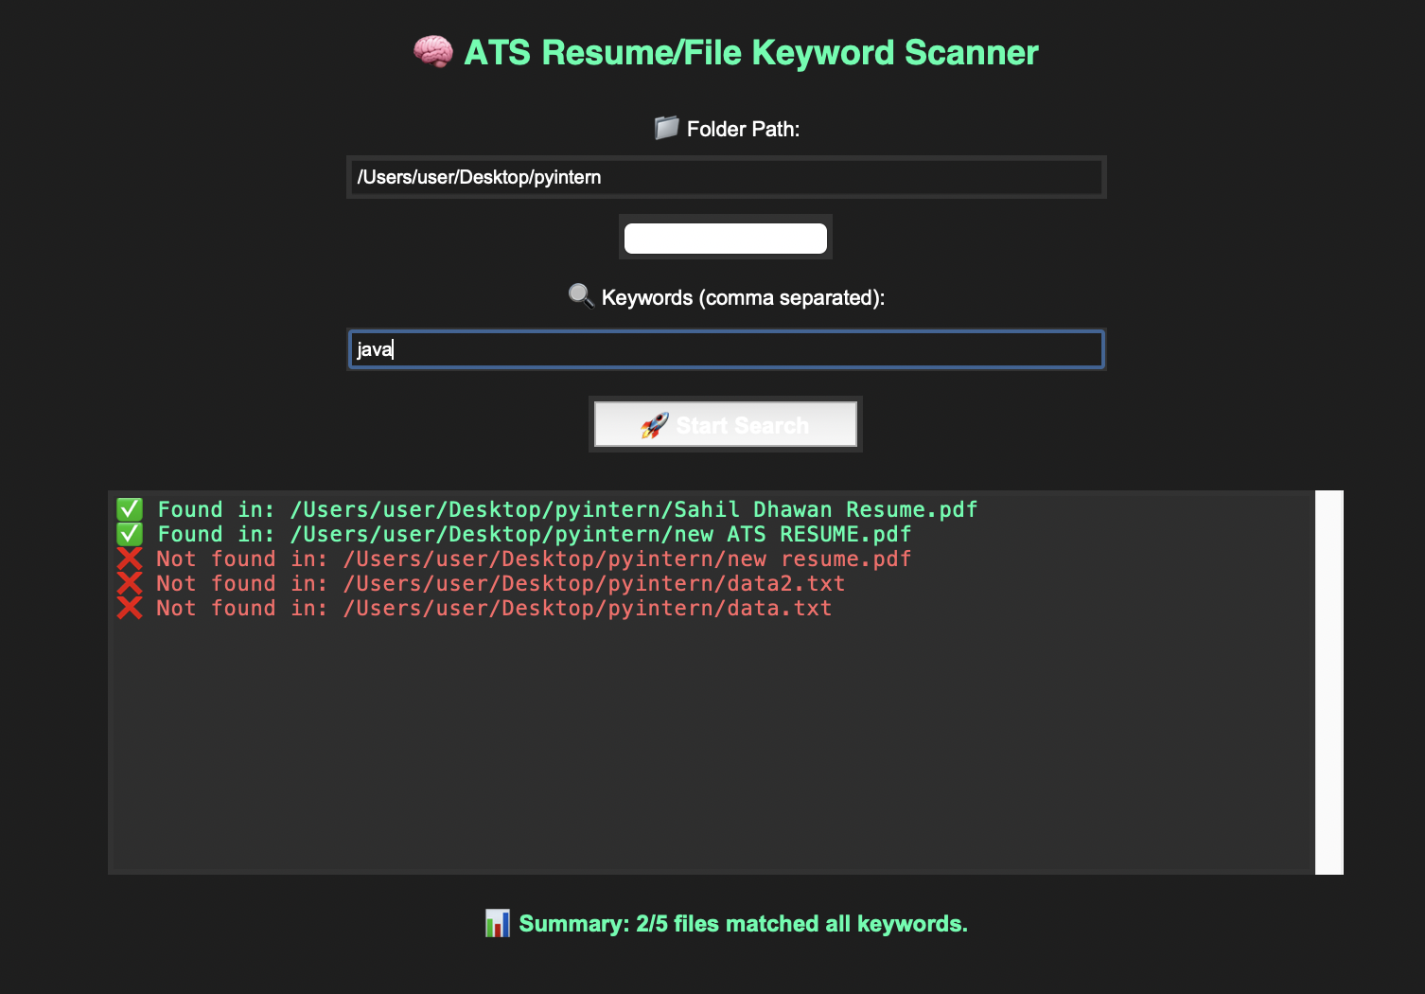

Slide 9
Features
✅ Supports multiple file formats (.pdf, .docx, .txt)
✅ Fast scanning using keyword logic
✅ Color-coded result view
✅ Simple, minimal GUI
✅ Works offline (no internet required)

Slide 10
Learnings
File Handling & Text Extraction in Python: Understanding the mechanics of processing files and extracting text using Python.
Building User-Friendly GUIs with Tkinter: Developing intuitive graphical user interfaces for enhanced user experience.
Applying Automation to Real-World HR Problems: Leveraging automation to solve practical challenges in Human Resources.
Debugging, Code Organization & User Testing: Best practices for identifying and fixing errors, structuring code, and validating solutions with users.

